Slide 1

PROJECT PROPOSAL
SOFTWARE ENGINEERING
< 102-08 >

Slide 2
TABLE OF CONTENTS
01
02
03
ABOUT THE PROJECT
MARKET OPPORTUNITY
APP FEATURES
04
05
06
REQUIREMENTS
SUMMARY OF INTERACTIONS
CONCLUSION
Concept introduction
Industry overview
What we want the app to do
Architecture
I/O interactions
Key points & Feedback
Notes:
IRENE: 2 / 4
ALBA: 3 / 5
PAULA: introduction + T.C. / 1 / 6

Slide 3

01
ABOUT THE PROJECT
PROJECT PURPOSE
PROBLEM IT WILL SOLVE
AUDIENCE / USERS
Create a software platform (MOBILE APP)
Speed up the search process of pet owners or pet sitters
Being able to travel while making sure your pets will be well attended
Make sure the tasks to do are completed
Make sure your home and pets will be secure
Help you find a job
Pet owners
Job seekers (with or without previous experience)

Slide 4

02
MARKET OPPORTUNITY

Slide 5
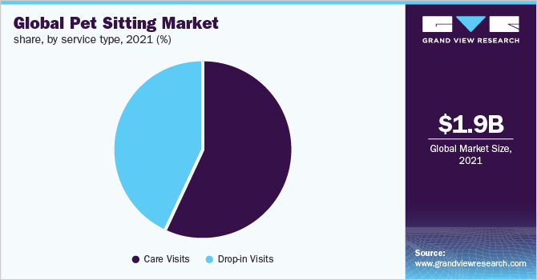
THIS IS NOW
The global pet sitting market size was estimated at USD 1.94 billion in 2021
SOURCE: GVR Report cover
Pet Sitting Market Size, Share & Trends Analysis Report By Pet Type (Dogs, Cats), By Service Type (Care Visits, Drop-in Visits), By Region (Asia Pacific, North America, MEA, Europe, LATAM), And Segment Forecasts, 2022 - 2030
Market size value in 2022: USD 2.15 billion

Slide 6
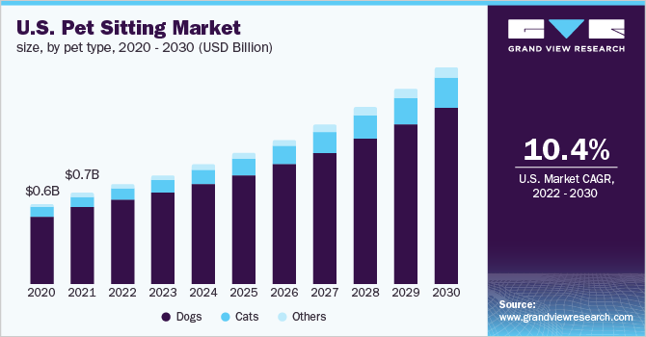
IN THE FUTURE
The global pet sitting market is expected to grow at a compound annual growth rate (CAGR) of 11.52% from 2022 to 2030.
Revenue forecast in 2030: USD 5.14 billion

Slide 7
03
APP FEATURES
Users information
Owner and pet/s (1 or more pets)
Sitter
Short recommendations about the sitter process
Searcher for owner’s offers or sitters in a previously specific zone range
In-app messages between both parts
Offers mailbox
Being able to pay the sitters from the app
Tasks register (with photos, hours done, ...)
GPS tracking while walking the dogs
Video call for emergencies
…

Slide 8
04
ARCHITECTURE REQUIREMENTS
FRONTED
(app building)
BACKEND
(app business logic)
EXTENDED
(extra features)
Mobile app user interface (UI)
Navigation library
API to make requests to the backend
Backend server
DBMS (to store information about users data)
Geolocation service for the location-based search
In-app messaging
Payment gateway integration
Push notifications
Review/Rating system
Calendar integration
Security and hardening interfaces
Notes:
Fronted: UI (to build the app components), Navigation library (to navigate between different screens and views), API
Backend: the backend server that handles the business logic and serves as the API for the mobile app
Extended: …. And the other extra features that we can add later on to upgrade the app.
And the Security and hardening interfaces to secure our platform with firewalls.

Slide 9

05
SUMMARY OF
INTERACTIONS

Slide 10
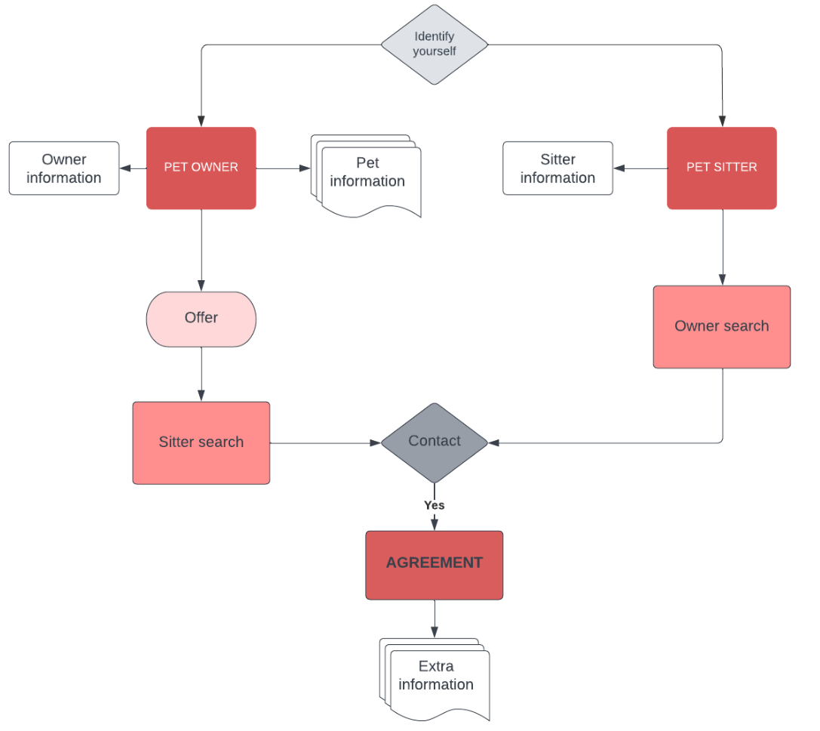
USER POINT OF VIEW

Slide 11
INPUTS OUTPUTS
User registration INFO
Profile Information
Search criteria
Search results
Sitter booking request
Booking confirmation
Payment information
Payment receipts
Sitter tasks done
Task confirmation
Admin Dashboard
Admin reports
User rating and review
Prev. ratings and reviews

Slide 12
PROJECT CONCLUSION
KEY 1
KEY 2
KEY 3
KEY 4
06
Global usage app
CAGR 11.52% (2022-2030)
Being able to make future updates and upgrades
High profit in a short and long term

Slide 13
WE APPRECIATE ANY FEEDBACK
THANK
YOU

